Slide 1
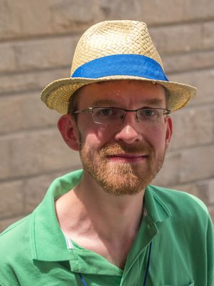

Slide 2
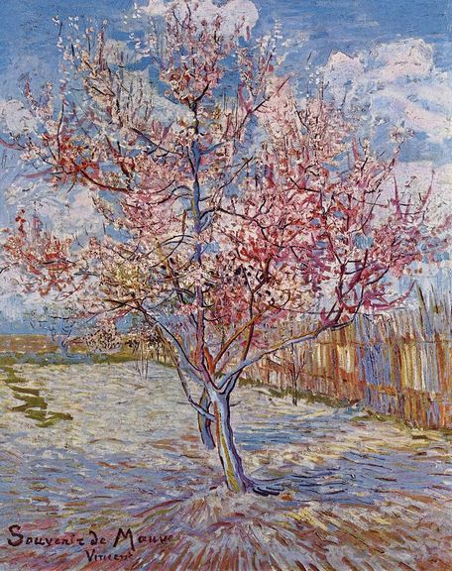
Trees
Vincent van Gogh
Souvenir de Mauve (Flowering peach trees)

Slide 3
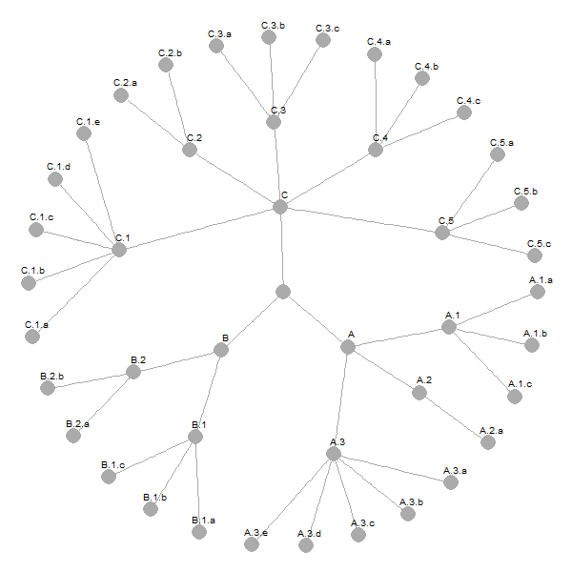
Tree-Structured data

Slide 4
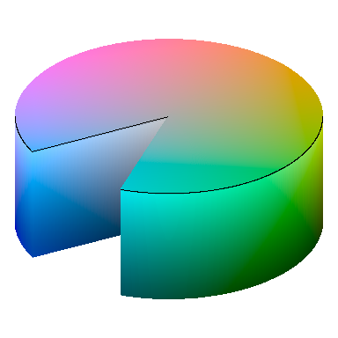
HCL color space
Chroma
Luminance
Hue
Well balanced perceptual properties

Slide 5
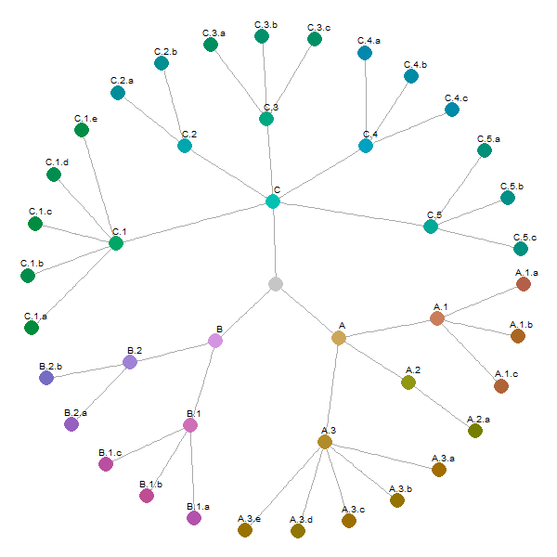
Tree Colors
Goal = support visual analysis
of tree-structured data

Slide 6
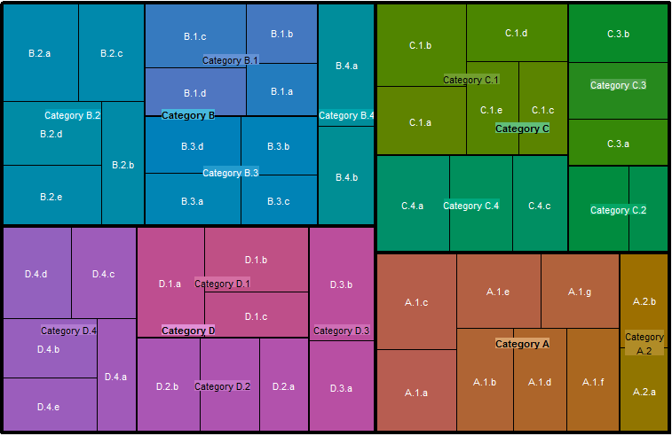
Tree Colors
Goal = support visual analysis
of tree-structured data

